Slide 1
Senior Data Engineer Project
David Bray

Slide 2
Running the code
After extracting the files from the tarball, do the following steps:
Setup a Python Virtual environment inside the highest-level folder
Activate and Install all the packages from the requirements.txt file (found in the highest-level folder) to the newly created virtual environment
Open the config.py file found in the SubFolders folder
Edit the paths of the save_path, zip_path, csv_extract_path, and sql_file_path variables
save_path – this path should end in the highest level directory, and the end of the path must have a .zip
zip_path – this path should be the exact same as save_path, but does not include the .zip portion
csv_extract_path – This the path for where your extracted csv files will be extracted to. I recommend a new folder in the highest level directory called “CSVFiles”
sql_file_path – this is where your sqlite database will be stored. The folder contains a sqlite → db directory already. Place that, and end the path with YourName.db
Ensure you are in the highest-level folder where the file “DavidBrayMain.py” file can be found
Run the “DavidBrayMain.py” file

Slide 3

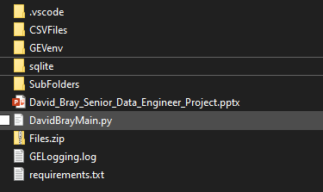
How to Know it Was Successful 1
The highest level directory should contain the files that are listed in this screenshot

Slide 4
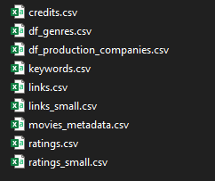
How to Know it was Successful 2
When navigating to the folder where you extracted the csv files, you should see the following csv files in the folder

Slide 5

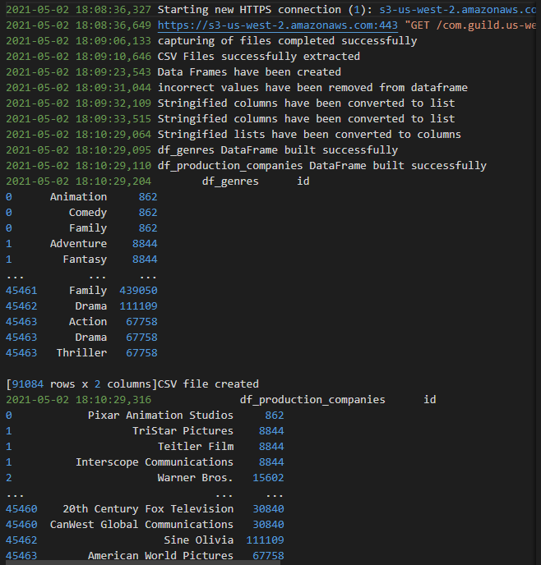
How to Know it was Successful 3
When checking the log file that gets created, you should see something that looks like the screenshot here

Slide 6
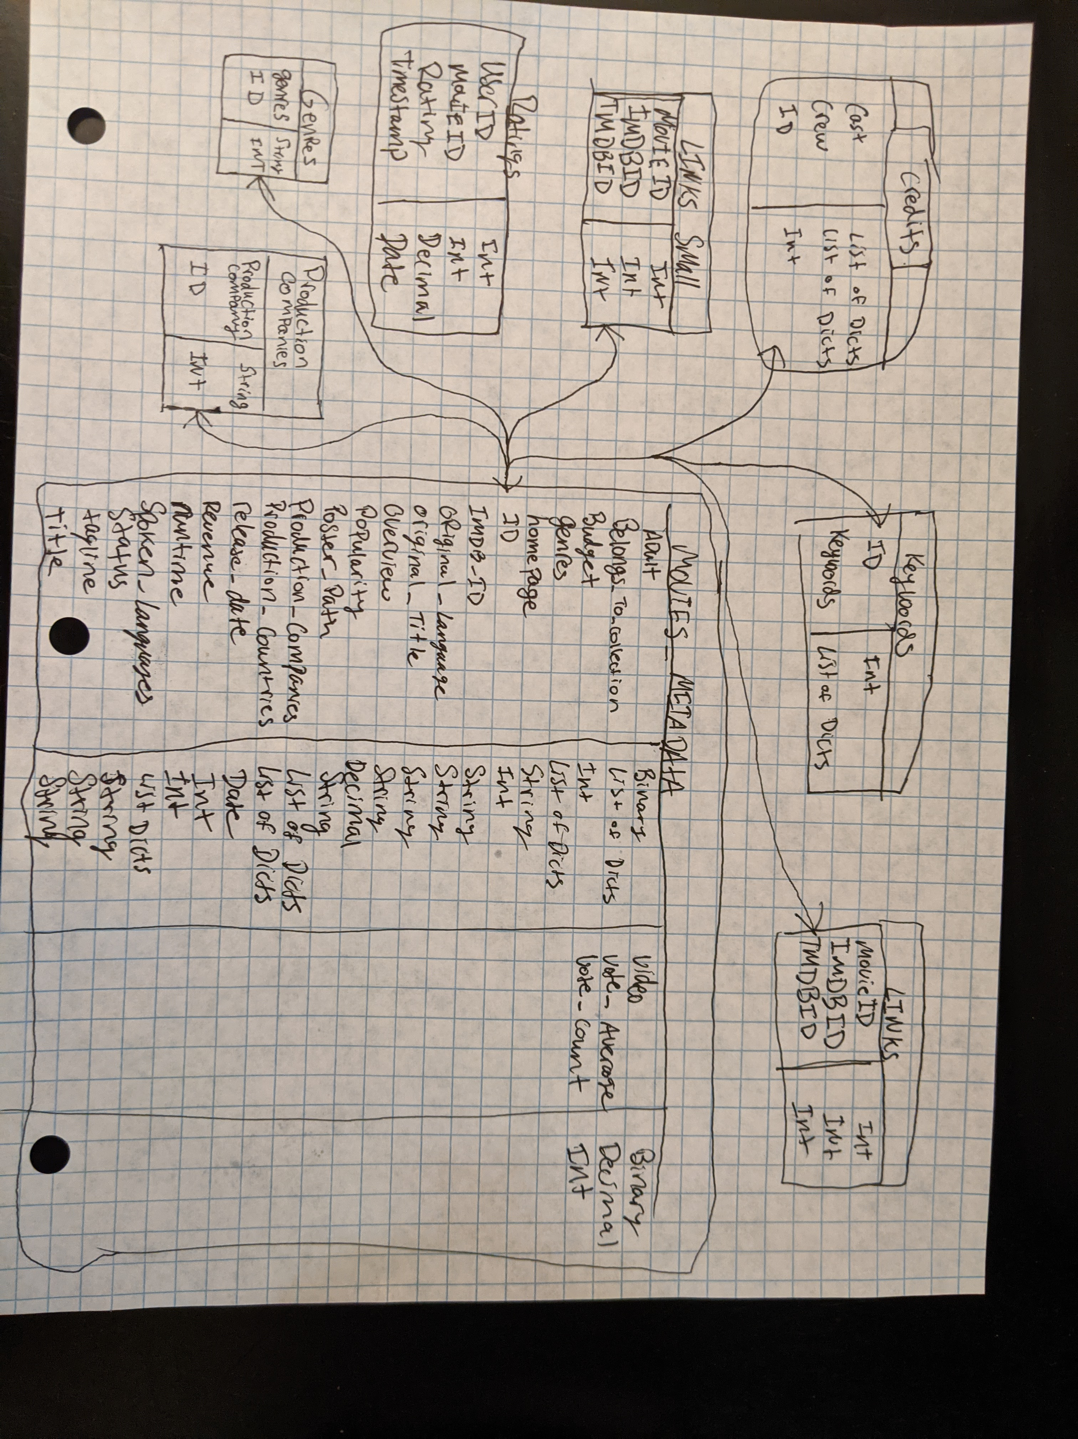
Data Model
The ID column is a common denominator across all the tables
We are able to create separate tables, and then join on the ID column to capture data across multiple tables
For columns with the List of Dictionaries, they can become their own table to separate all of the possible outcomes by movie ID by running their column through my code
The separate tables for these unique columns can be scaled up as much as needed, and have low overhead because they are only a 2 column table
The movies_metadata table contains most of the information we want and will want in the future, so it is important to include as much of the data as possible so it is evolvable for future needs

Slide 7
Scaling and Maintaining the System
A 100X increase in data volume would require some design changes to ensure the pipeline performed to a reasonable level
Need a better connection to the data source – currently you have to hit an S3 endpoint to gain access to the files. Downloading this much data over the internet is a time-consuming process. You must stream the data to get it to your model. A direct connection to the data would allow you to skip the first step of downloading the data
Put the data into a data lake before doing any transformation work. This would allow you to then apply an enterprise level workflow tool to the data and transform lots of data at a quicker rate, and then push that data to the desired end data model
Apply a batch processing method to the data to process all of the data at once
Implement a cloud based solution such as Hive or Spark around the data depending on the specific business requirements

Slide 8
Scaling and Maintaining the System
For an hourly update cadence, you will need to set this up with a scheduling manager, such as the Schedule pipeline component that AWS offers
Depending on the scheduling manager that is chosen, it will offer different options around how often to run the pipeline. You can configure an hourly cadence
AWS also offers AWS CloudTrail, which will capture any API calls and logging information related to the pipeline. This logging information can be sent to another application, such as an S3 bucket where it can be further analyzed and used to check performance of the pipeline

Slide 9
Data Reprocessing
To backfill a years worth of data, once the data is ready to be loaded to the data model, it can be staged for loading
This staging can be a temporary database that is used to housed all of the data needing backfilled
To limit the impact on your regular production flow, you can schedule the backfill to run outside of normal runs on the workflow
If this is not an option, you can create a merge flow, where the two data flows get combined together and sent through the final pipeline together
If the need to backfill the data is not strong, then you can setup a workflow that adds only a small amount of backfilled data through the pipeline at a time to keep the pipeline from being overloaded

Slide 10
Error Handling
In the current solution, I am using Python’s built-in logging mechanism to capture and record errors
The main way I am handling these errors is through try except blocks in the code
For a more scalable solution, you could create a separate database for the log files, and make an alerting mechanism if a log shows an error so the error can be fixed quickly
Another option for error handling is to use a 3rd party error handler, or something native to the solution where your pipelines currently exist. For AWS, this example would be AWS CloudWatch

